Slide 1



TxACE
mmWave Radar for Gesture Recognition
Josiah W. Smith
In collaboration with:
Dr. Torlak, Dr. Makris
S. Thiagarajan, B. Upadhyay, R. Willis
University of Texas at Dallas
February 13th, 2019

Slide 2
Hand Gesture Recognition
Goal: Demonstrate real-time hand gesture recognition using FMCW mmWave radar
For future application with THz imager
Investigate how the back-scattered signal changes due to dynamic (motion) hand gestures
Develop MATLAB application to collect large hand gesture signal data sets
Identify features which are suitable for scattered radar waveforms and immune to the background noise
Develop fine-grain signal processing based on space-range-Doppler analysis to improve machine learning accuracy

Slide 3
Outline
FMCW Basics
Static Data Collection Applications
Static Hand Gesture Recognition
Old Setup
New Setup
Conclusions and Future Work

Slide 4
FMCW Basics

Slide 5
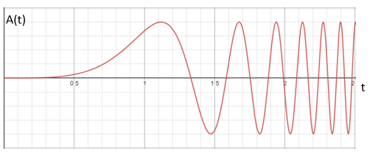
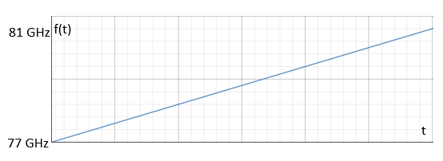
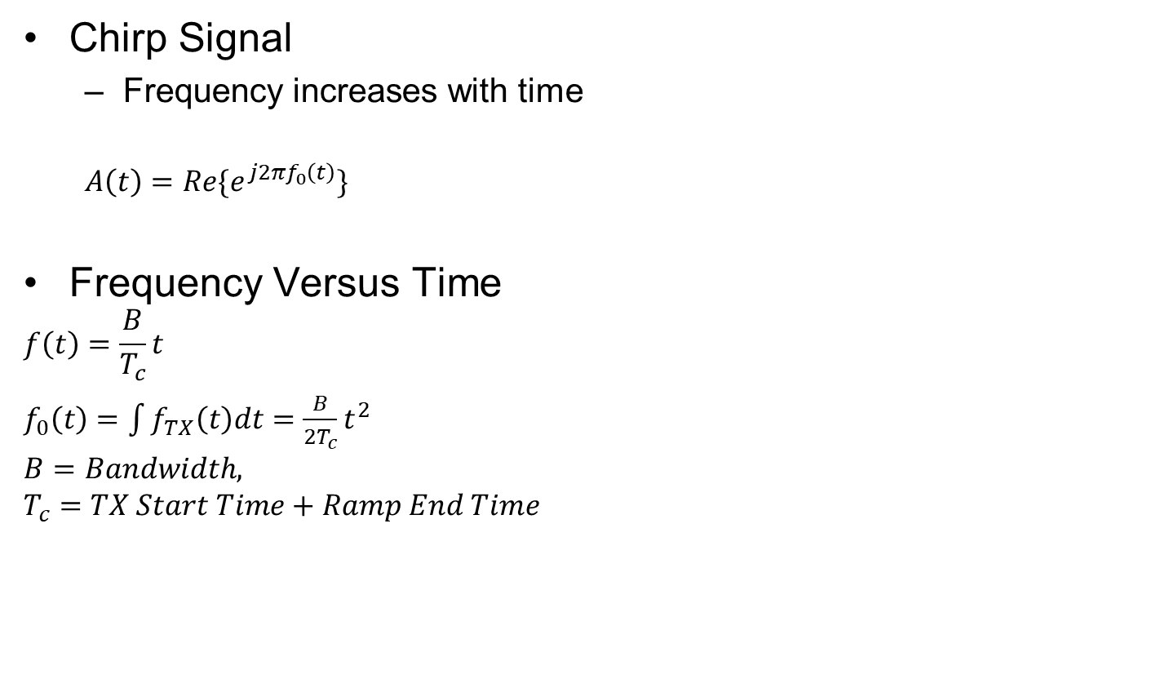
FMCW Chirp
Chirp Signal
Frequency increases with time
$$A\left(t\right)={Re\{e}^{j2πf_{0}\left(t\right)}\}$$
Frequency Versus Time
$$f\left(t\right)=\frac{B}{T_{c}}t$$
$f_{0}\left(t\right)=\int{f_{TX}\left(t\right)dt}=\frac{B}{{2T}_{c}}t^{2}$
$$B=Bandwidth,$$
$$T_{c}=TX Start Time+Ramp End Time$$

Slide 6
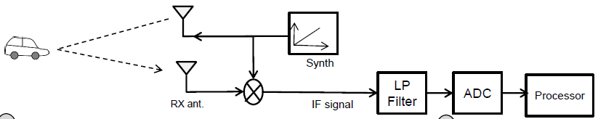
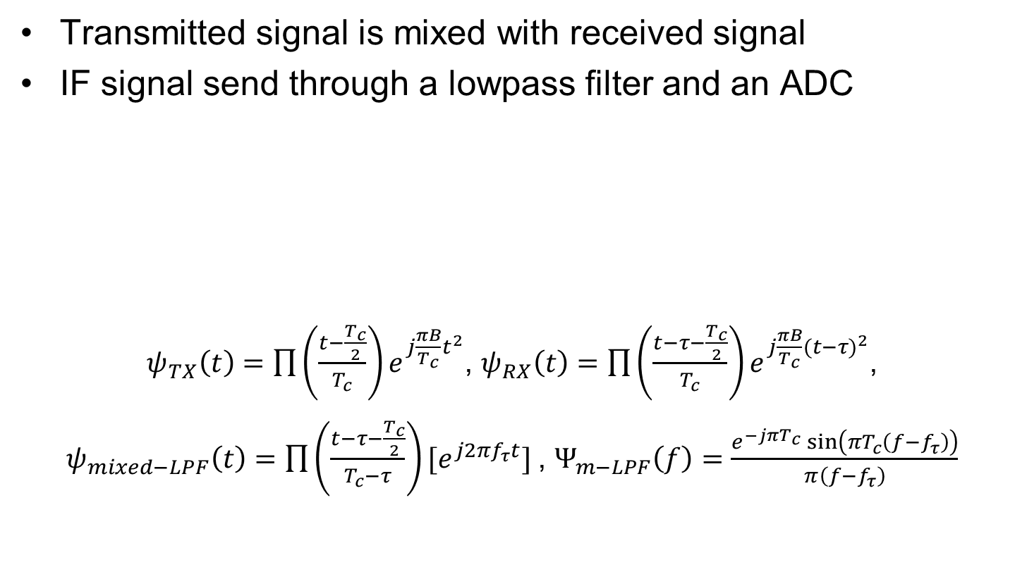
Signal Flow
Transmitted signal is mixed with received signal
IF signal send through a lowpass filter and an ADC
$ψ_{TX}\left(t\right)=\prod{\left(\frac{t−\frac{T_{c}}{2}}{T_{c}}\right)e^{j\frac{πB}{T_{c}}t^{2}}}$, $ψ_{RX}\left(t\right)=\prod{\left(\frac{t−τ−\frac{T_{c}}{2}}{T_{c}}\right)e^{j\frac{πB}{T_{c}}({t−τ)}^{2}}}$,
$ψ_{mixed−LPF}\left(t\right)=\prod{\left(\frac{t−τ−\frac{T_{c}}{2}}{T_{c}−τ}\right){[e}^{j{2πf}_{τ}t}] }$, $Ψ_{m−LPF}\left(f\right)=\frac{e^{−jπT_{c}}\sin\left(πT_{c}\left(f−f_{τ}\right)\right)}{π\left(f−f_{τ}\right)}$

Slide 7
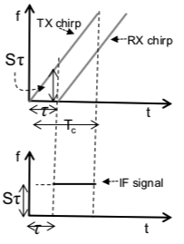
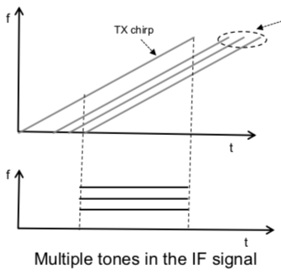
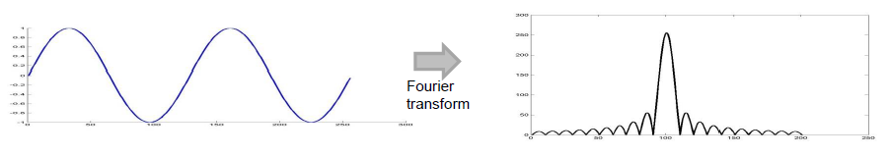
FT of Received Signal
Time-frequency plot of chirp and received chirp
Single reflection results in one peak in frequency/range domain

Slide 8
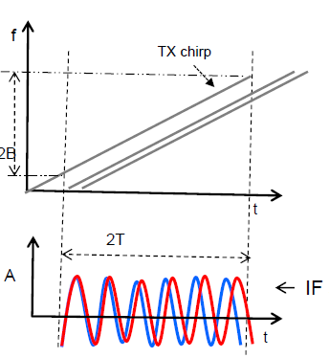
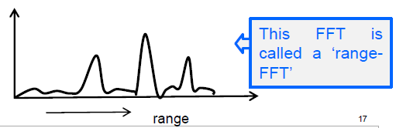
FT of Received Signal
Multiple reflections result in multiple peaks in the range domain.
For gesture case, many peaks and noise can be seen in the range spectrum.

Slide 9
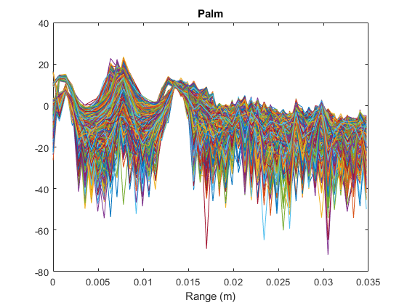
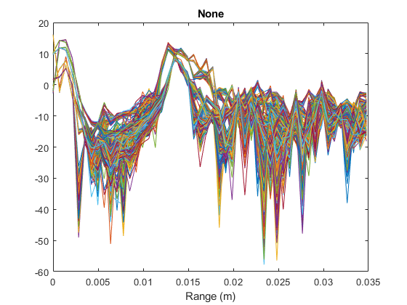
Range Analysis
Range spectrum

Slide 10
Static Data Collection Applications

Slide 11
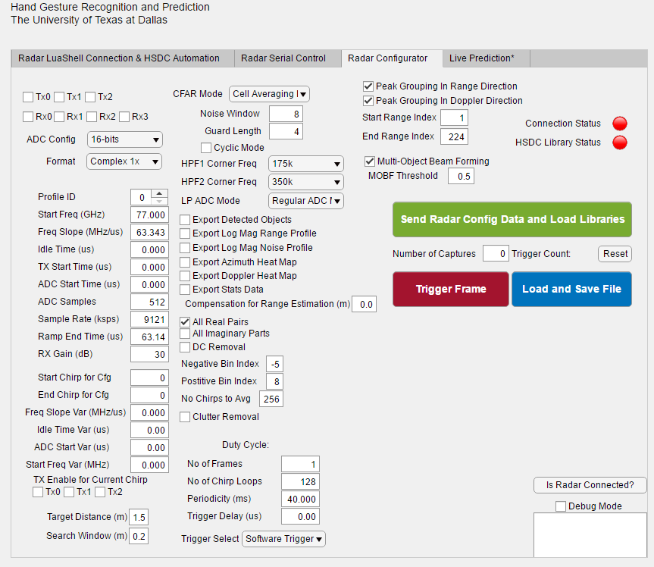
MATLAB HGR App
Detailed control over radar settings and configuration
High-Speed LVDS Interface will allow for transfer of raw data without HSDC.
In testing phase, we are improving automation and real-time programs

Slide 12
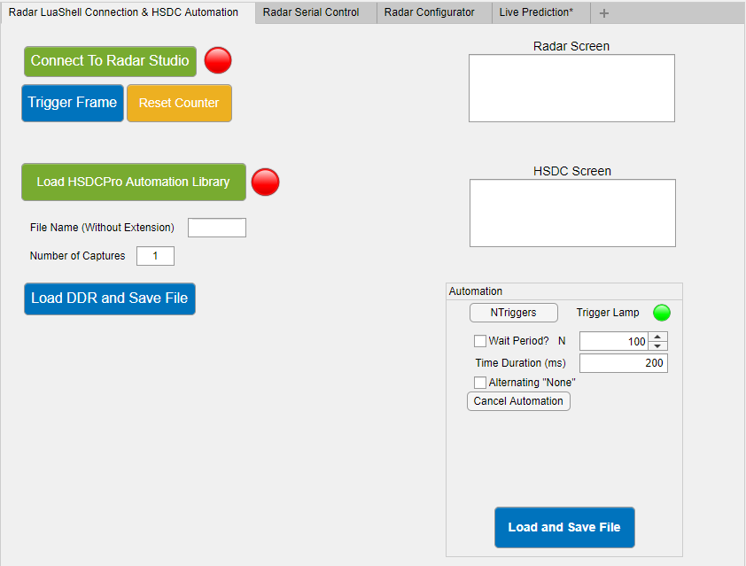
Automation through MATLAB App
App capable of collecting an arbitrary number of captures as needed
Specify periodicity of capture for bulk capturing of data
Load data and save directly from GUI

Slide 13
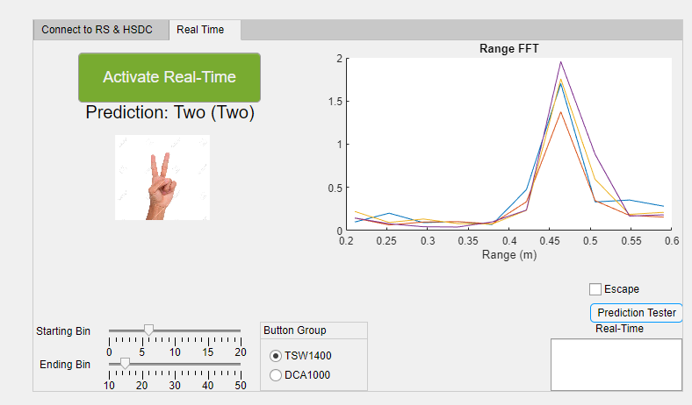
MATLAB HGR App
Capture data and display the prediction
2D FFT
Comparison of methods
Select range for comparison
Uses multiple neural networks for classification
Preprocessing to emphasize characteristics

Slide 14
Static Hand Gesture Recognition

Slide 15
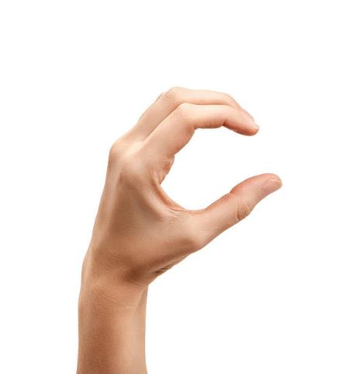

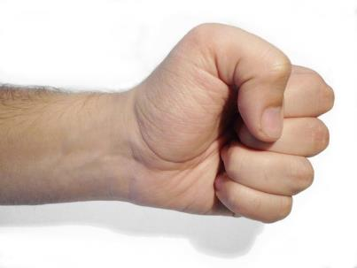

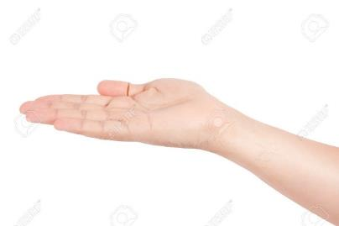

Static Hand Gestures
Fist
C
Palm
Perpendicular (perp)
Thumbs Up (tu)
Two

Slide 16
OLD Static Experiment Parameters
Using TI mmWave radar equipment is set up specifically for hand gesture data collection.
Samples are taken of each hand static gesture from a distance of 0.4m to 0.5m from radar with a constant, distant background.
Five gestures are used in addition to a ‘none’ gesture (without any hand in the specified range)
Radar Parameters:
1 TX, 4 RX
16bit, Complex1x
Start Frequency: 77GHz Old Maximum Range:
Bandwidth: 3.99948GHz R_{max} = 21.58m
Slope: 63.343 Hz/s
ADC Samples: 512
Sample Rate: 9121 ksps

Slide 17
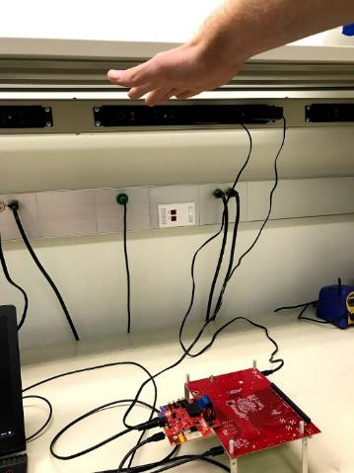
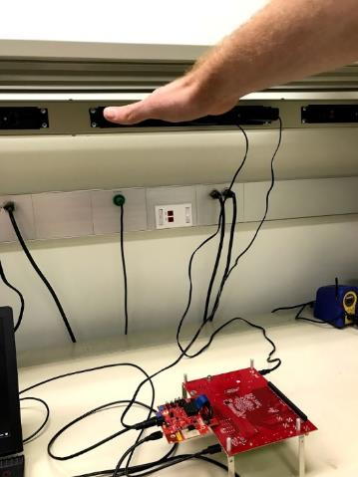
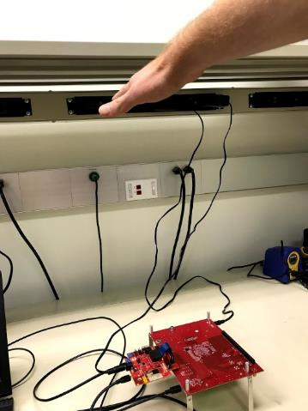
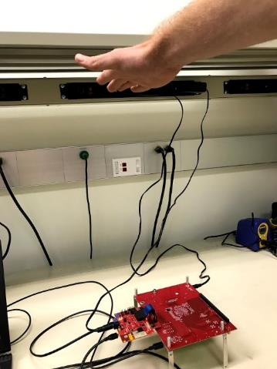
OLD Static Data Collection
Using automation program, collection of bulk data for maximum independence among captures
Distance from sensor varied from 0.4m to 0.5m
Angle with respect to sensor varied approximately ±30° in every direction
Start Lower Angled Angled

Slide 18
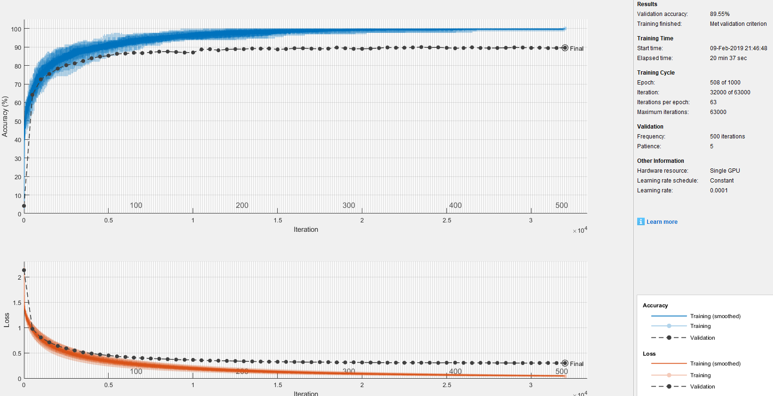
OLD Results
Neural network training with large, varied datasets
89.55% Accuracy with layered imaginary and real parts

Slide 19
NEW Static Experiment Parameters
Using TI mmWave radar equipment is set up specifically for hand gesture data collection.
Samples are taken of each hand static gesture from a distance of 0.35m to 0.55m from the radar with a constant, distant background.
Six gestures are used in addition to a ‘none’ gesture (without any hand in the specified range)
Radar Parameters:
3 TX, 4 RX (12 Virtual MIMO Channels)
16bit, Complex1x
Start Frequency: 77GHz New Maximum Range:
Bandwidth: 3.99948GHz R_{max} = 3m
Slope: 99.987 Hz/s
ADC Samples: 64
Sample Rate: 2000 ksps

Slide 20
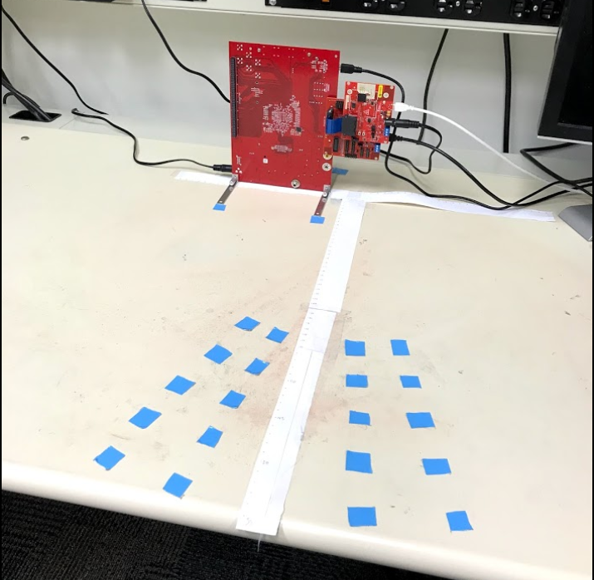
New Setup
Horizontal orientation
25 hand locations
35-55cm range
Increments of 5cm
Azimuth angles of 7°
and 14° on either side
Little to no variation
vertically

Slide 21
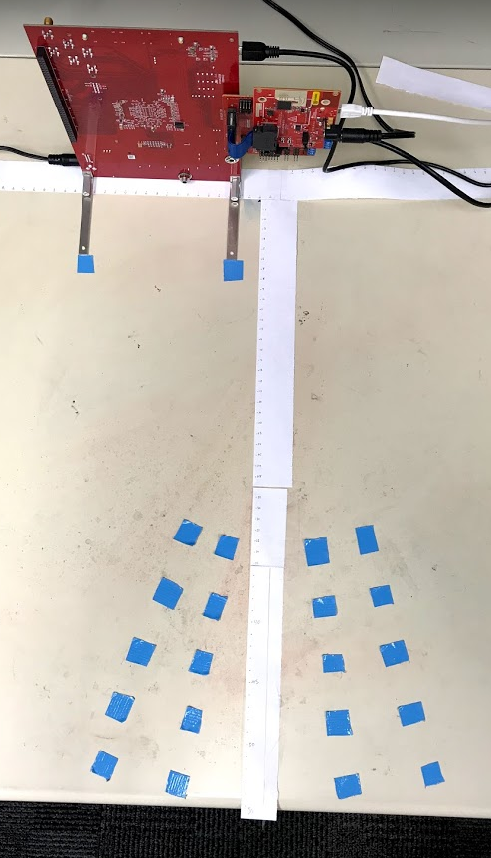
New Setup
As shown below, capture FOV ranges from 35-55cm
across a FOV of
28°, at increments
of 5cm.
7°
14°
35cm
7°
55cm
14°
5cm

Slide 22
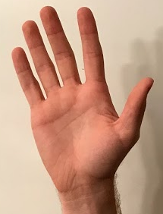
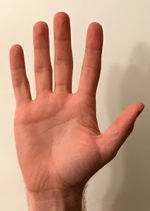
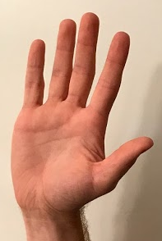
Degrees of Freedom
30° of rotation in each direction
Side to side
Forward and backward
Left and right
Different hands used (different reflectivity etc.)
30°
30°

Slide 23
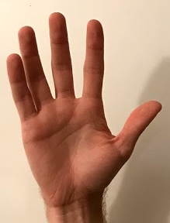
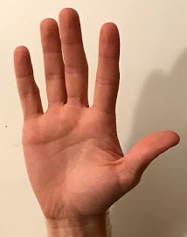
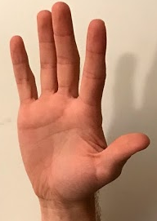
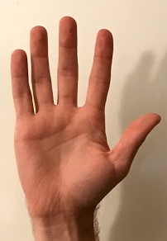
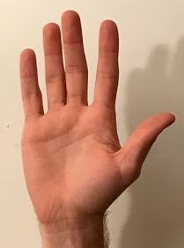
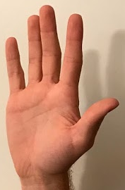
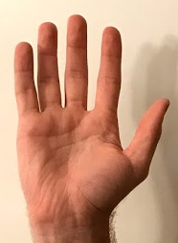
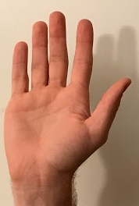
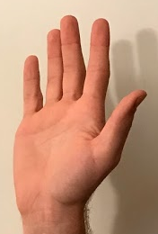
Degrees of Freedom
30°
30°
30°
30°

Slide 24
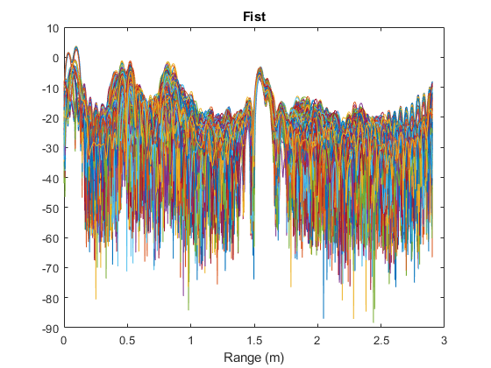
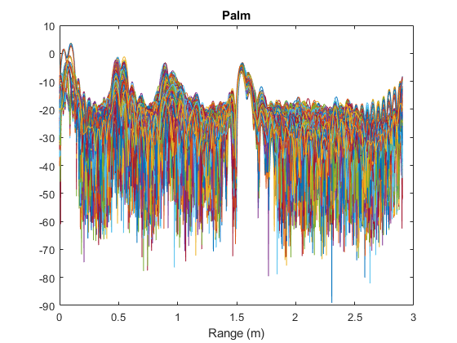
New Raw Range Data

Slide 25
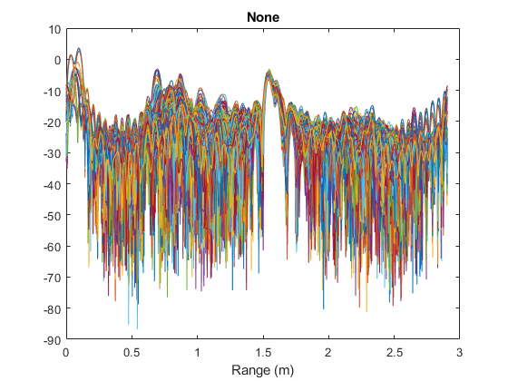
New Raw Range Data

Slide 26
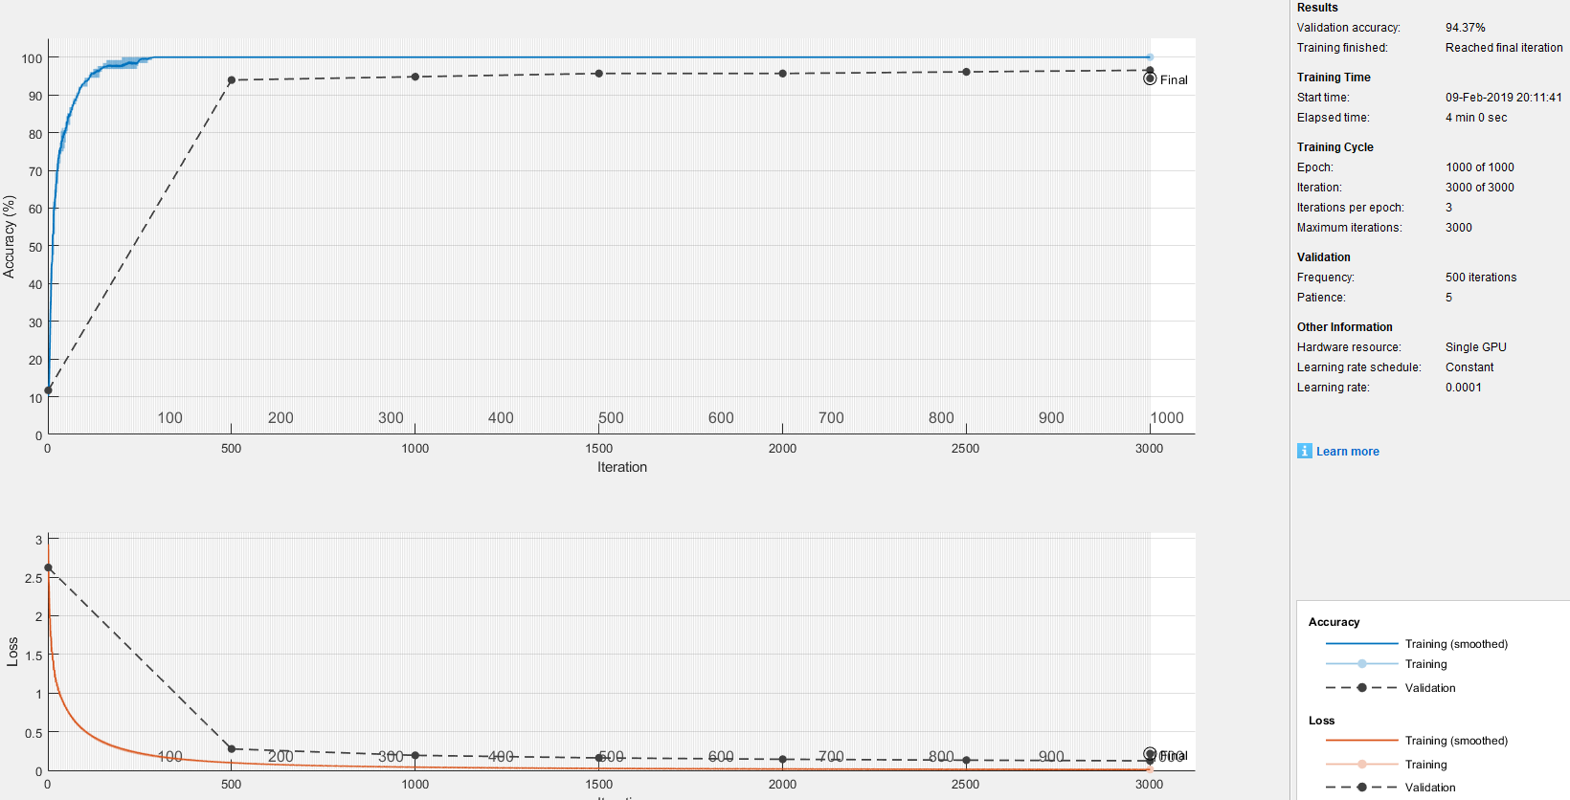
Preliminary CNN
Neural network training with preliminary, small dataset
94.17% Accuracy with layered imaginary and real parts

Slide 27
Preprocessing
Increased FFT size
Increases number of features from which machine learning algorithm can choose
Complex Normalization
Average the data across captures
Find maximum of average for each channel
Normalize by the complex value of this maximum
Normalize to zero mean and unit variance

Slide 28
New Normalized Data

Slide 29
New Normalized Data

Slide 30
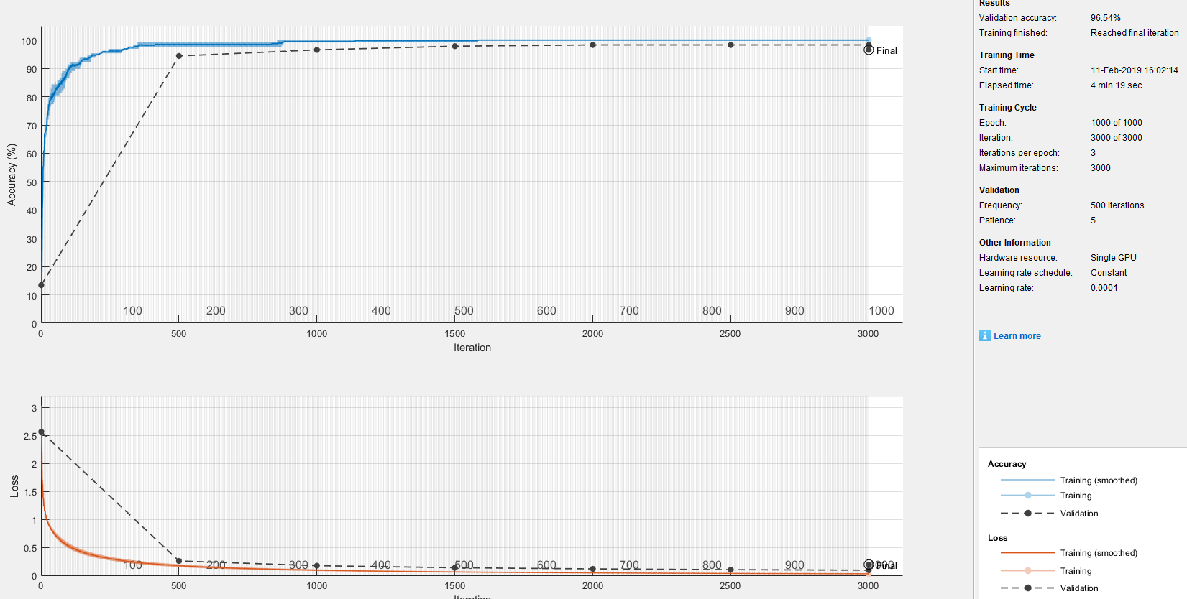
CNN with Normalized Data
Neural network training with preliminary, small dataset
96.54% Accuracy with layered imaginary and real parts

Slide 31
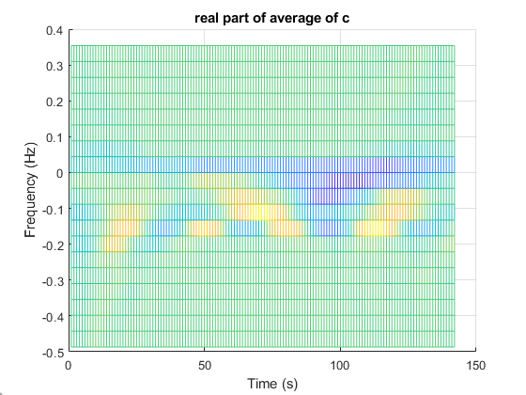
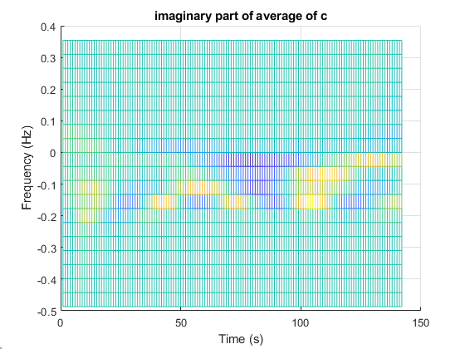
Time-Freq Preprocessing
Short Time Fourier Transform (STFT) and Continuous Wavelet Transform (CWT)
To utilize time-frequency components
Fourier Synchrosqueezing Transform (FSST)
Circumvents uncertainty relations found in STFT and CWT [2]

Slide 32
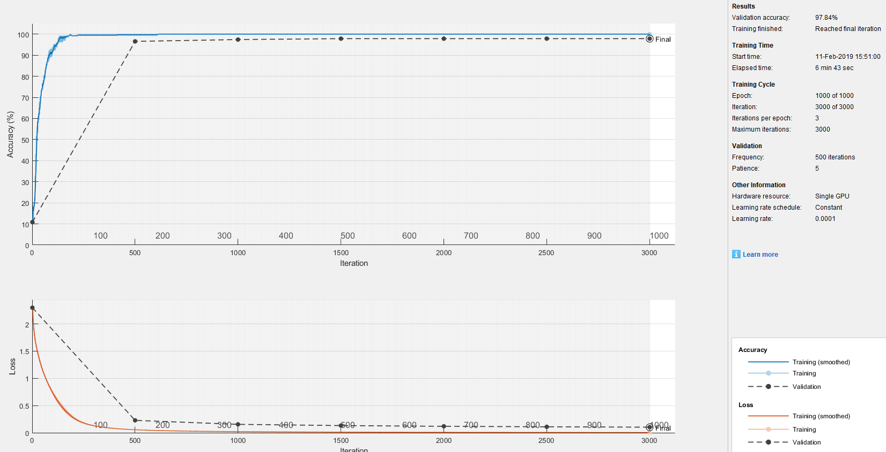
CNN with FSST Normalized Data
Neural network training with preliminary, small dataset
97.84% Accuracy with layered imaginary and real parts

Slide 33
Conclusions and Future Work
Static gesture recognition
Updated settings producing increased accuracy
Automated data collection to obtain large data sets
Preprocessing techniques (normalization, FSST) improving accuracy by emphasizing features
Real-time system coming soon
Dynamic gesture recognition
Once static case is optimized
Doppler information utilized
High resolution should yield high accuracy
Sub-millimeter radar using THz imager

Slide 34
References
[1] S. Rao, "Introduction to mmwave Sensing: FMCW Radars", Texas Instruments.
[2] A. Wojciechowska, "Usage des archives ouvertes dans les domaines des mathématiques et de l'informatique", Documentaliste-Sciences de l'Information, vol. 43, no. 5, p. 294, 2006. Available: 10.3917/docsi.435.0294.

Slide 35
TxACE
mmWave Radar for Gesture Recognition
Josiah W. Smith
In collaboration with:
Dr. Torlak, Dr. Makris
S. Thiagarajan, B. Upadhyay, R. Willis
University of Texas at Dallas
February 13th, 2019

Slide 36
Excess Slides
Not to be used

Slide 37
Dynamic Hand Gestures

Slide 38
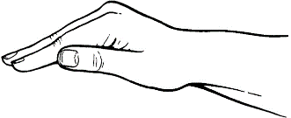
Dynamic Hand Gesture Recognition
Consider two dynamic hand gestures, pushing (down) and pulling (up)
We expect the pushing (down) motion to result in a positive velocity as it is coming towards the radar.
Similarly, we expect the pulling (up) motion to result in a negative velocity.
Pulling
Pushing
RADAR

Slide 39
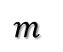
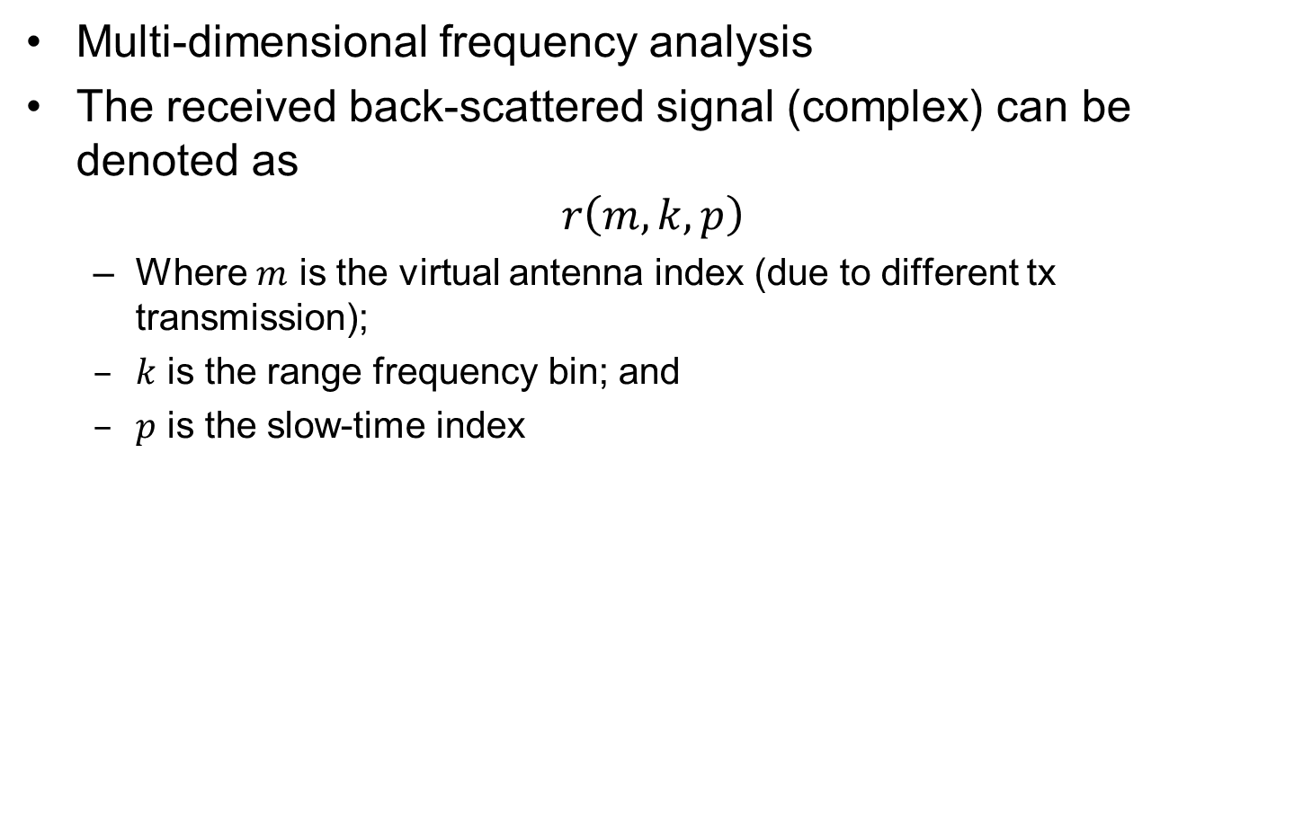


Space-Range-Doppler Analysis
Multi-dimensional frequency analysis
The received back-scattered signal (complex) can be denoted as
$$r\left(m,k,p\right)$$
Where $m$ is the virtual antenna index (due to different tx transmission);
$k$ is the range frequency bin; and
$p$ is the slow-time index
Data cube
$m$
$k$
$$p$$

Slide 40
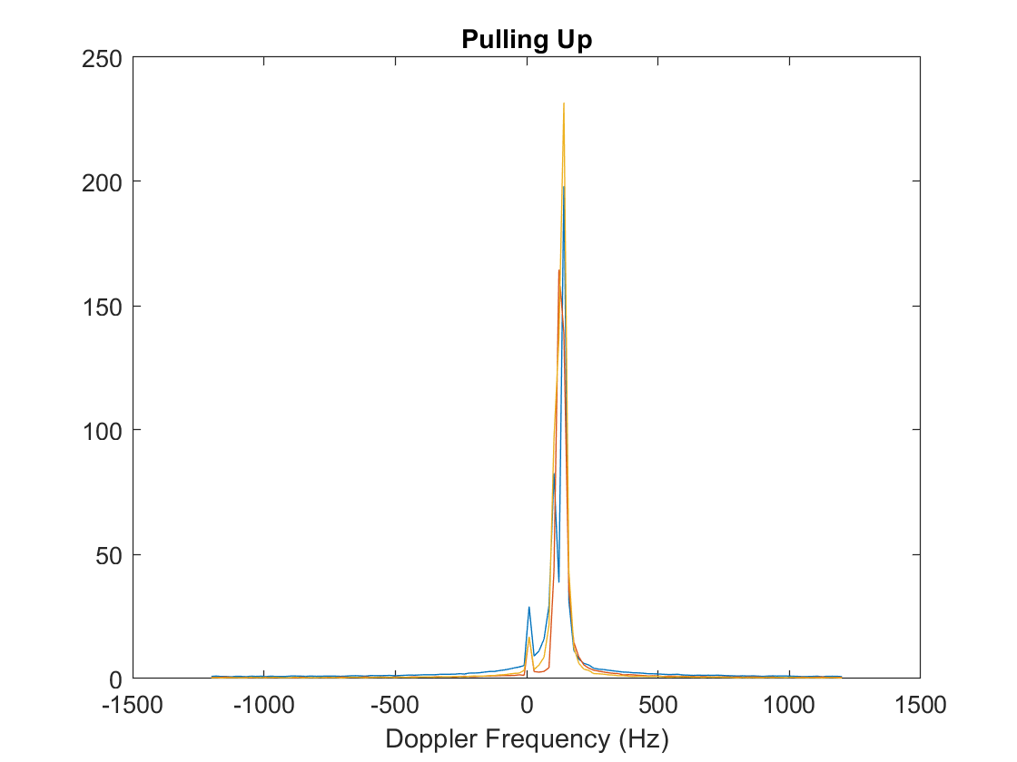
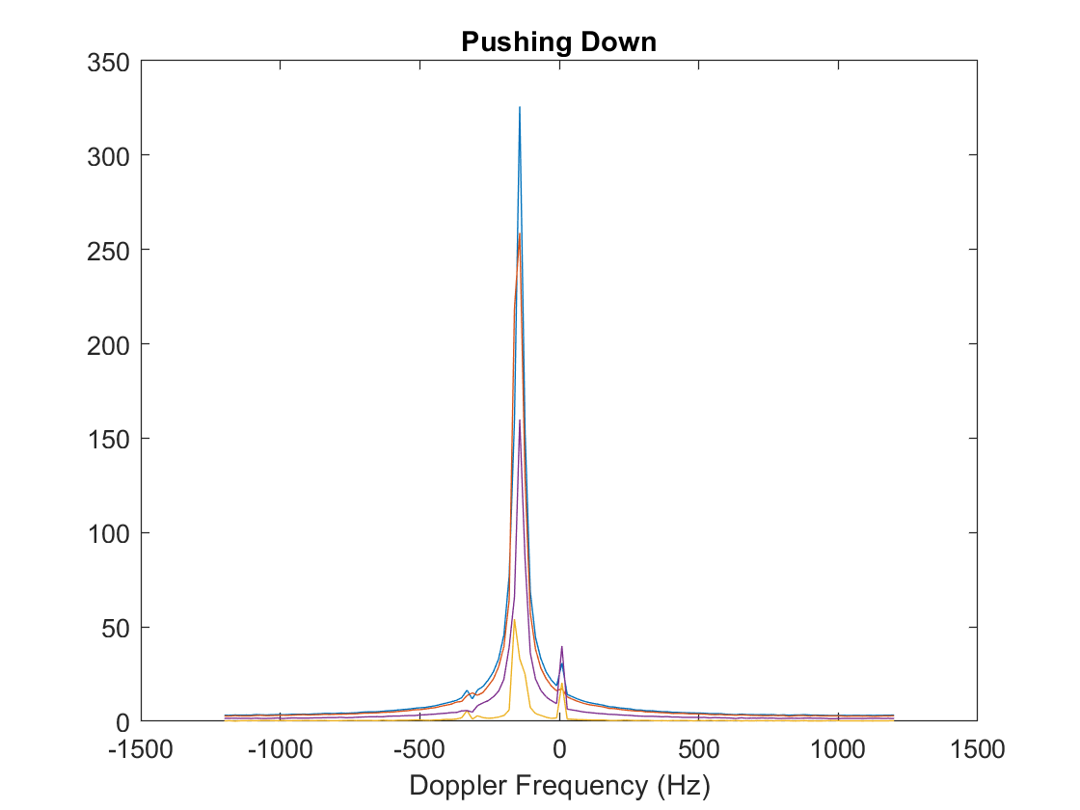
Doppler Processing
Pulling up vs pushing down

Slide 41


Dynamic Hand Gesture Example
Range Frequency-Slow Time Analysis

Slide 42

Dynamic Results
Neural network training with
97.31% Accuracy considering only magnitude of response

Slide 43
Infrared Gesture Recognition

Slide 44






IR images of static hand gestures
Two
Fist
Perpendicular
Curl
Palm

Slide 45

Live HGR with IR Sensors
Real-time IR-based gesture recognition using a convolutional neural network

Slide 46


Radar Waveform Selection for Imager
Pulsed waveforms, i.e., FSK
Chirp (FMCW)
Stepped Frequency Waveforms
Unambiguous range
$$ΔR=\frac{c}{2B}$$

Slide 47


Transmitted Signal
Chirp Signal is in the form: $ψ_{TX}\left(t\right)=\prod{\left(\frac{t−\frac{T_{c}}{2}}{T_{c}}\right)e^{j\frac{πB}{T_{c}}t^{2}}}$
TX Signal: $\sum_{n=1}^{N_{chirps}}{\prod{\left(\frac{t−\frac{T_{c}T_{F}}{2}}{T_{c}}\right)e^{j\frac{πB}{T_{c}}t^{2}}}}$
Signal is repeated N_{chirps} times with a periodicity of T_{F}
Transmitted signal sent from TX antenna and
signal received back 𝜏 seconds later.
Signals are mixed to produce IF signal
(note: Π is the unit rectangle function)

Slide 48

Received Signal
From one chirp, received signal comes in the form:
$$ψ_{RX}\left(t\right)=\prod{\left(\frac{t−τ−\frac{T_{c}}{2}}{T_{c}}\right)e^{j\frac{πB}{T_{c}}({t−τ)}^{2}}},τ=\frac{2d}{c}$$
Therefore $f_{RX}(t)=\frac{d}{dt}\frac{1}{2π}\frac{πB}{T_{c}}{\left(t−τ\right)}^{2}=\frac{B}{T_{c}}(t−τ)$

Slide 49


Received Signal
Mixed with the TX signal then sent through a LPF
$$ψ_{mixed}\left(t\right)=\prod{\left(\frac{t−τ−\frac{T_{c}}{2}}{T_{c}−τ}\right){[e}^{j\frac{πB}{T_{c}}[t^{2}−\left({t−τ)}^{2}\right]}]=\prod{\left(\frac{t−\frac{T_{c}}{2}}{T_{c}−τ}\right){[e}^{j\frac{πB}{T_{c}}\left[2τt−τ^{2}\right]}] }}$$
$ψ_{mixed−LPF}\left(t\right)=\prod{\left(\frac{t−τ−\frac{T_{c}}{2}}{T_{c}−τ}\right){[e}^{j\frac{2πB}{T_{c}}τt}] }$ a single tone signal

Slide 50

FT of Received Signal
As shown to the left, the frequency of the received signal is time delayed 𝜏 seconds.
$$d−distance to object, c−speed of light$$
$${S_{τ}(as shown)=f}_{τ}=\frac{2dB}{cT_{c}}$$
Multiple Reflections from objects

Slide 51

FT of Mixed Signal
$$ψ_{mixed−LPF}\left(t\right)=\prod{\left(\frac{t−τ−\frac{T_{c}}{2}}{T_{c}−τ}\right){[e}^{j{2πf}_{τ}t}] }$$
$$Ψ_{m−LPF}\left(f\right)=\frac{e^{−jπT_{c}}\sin\left(πT_{c}f\right)}{πf}∗δ\left(f−f_{τ}\right)=\frac{e^{−jπT_{c}}\sin\left(πT_{c}\left(f−f_{τ}\right)\right)}{π\left(f−f_{τ}\right)}$$
Zeros: $\frac{1}{T_{c}}$, Center Middle Frequency: $f_{τ}=\frac{2dB}{{cT}_{c}}$

Slide 52

Multiple Reflections
For multiple reflections, the range/frequency spectrum shows peaks at multiple range bins. Each gesture’s frequency response has minor differences from each channel perspective

